Slide 1
Improving the Usability
of Government Program Reports
Prototype Demo Screenshots
Team : Aakash Dolas, Davis Craig, Eashwari Samant, Tyler Faris

Slide 2
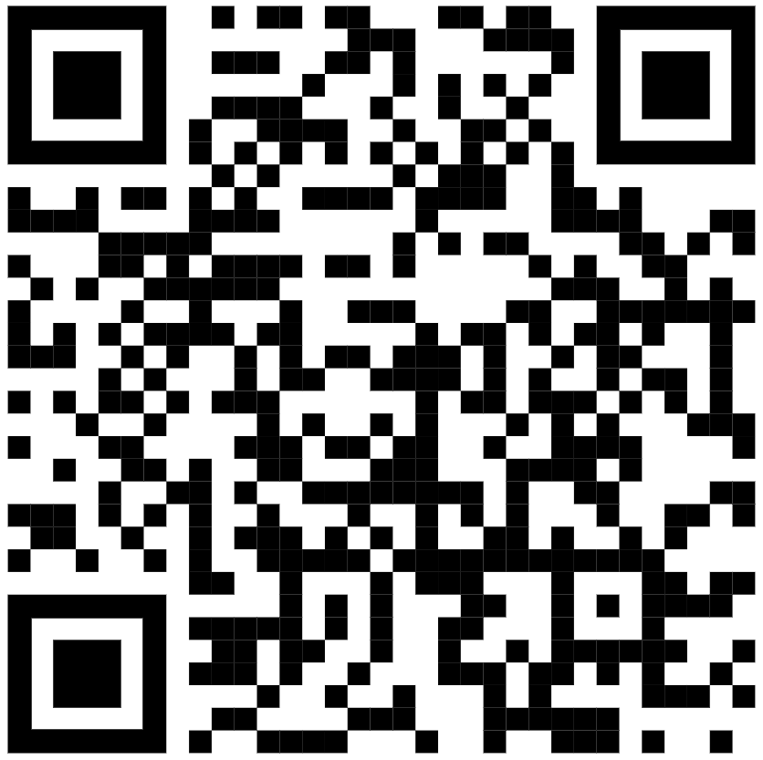
Overview
The following slides have screenshots of the first-pass prototype that we have built for preliminary validation. The front end consists of two parts - one where the user can upload a PDF (this interface is not shown in the screenshots) and the other where they can input a query in natural language and the prototype will pull up data from within the uploaded PDF’s specific page number and section (with highlighted text). Our solution is a vector-database powered LLM with a chatbot-like UI on the front end. Based on our research, our hypothesis for proto validation is that this tool will help policy analysts significantly reduce the amount of hours spent in finding a specific data point in these program reports.
Link to prototype - https://govscan-6ea702316640.herokuapp.com/
Username: govscan
Password: pil23gov
GovScan © 2023 by Davis Craig is licensed under CC BY-NC-SA 4.0

Slide 3
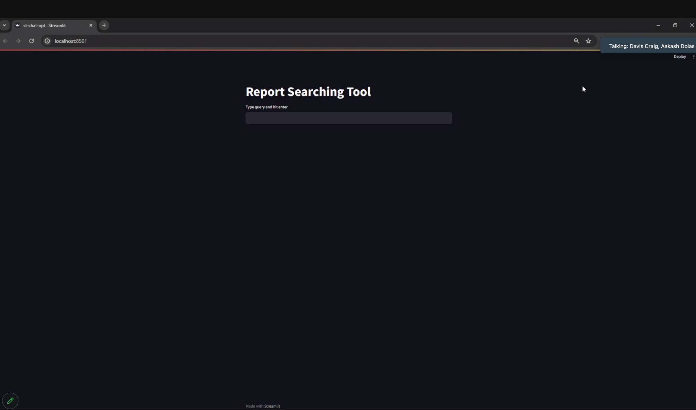

Slide 4
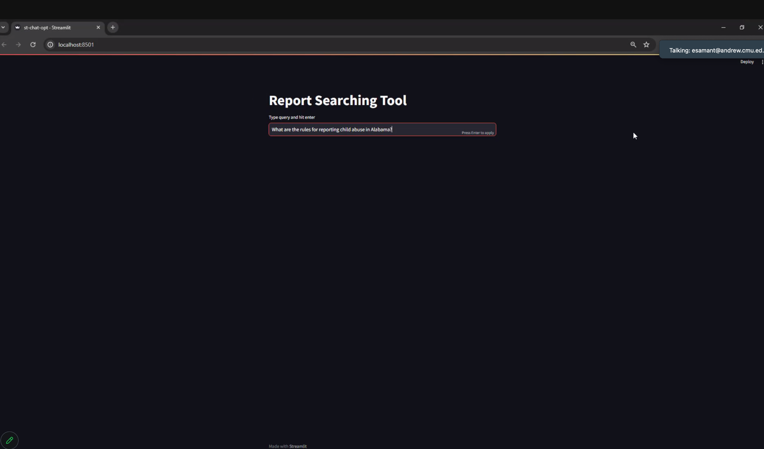

Slide 5
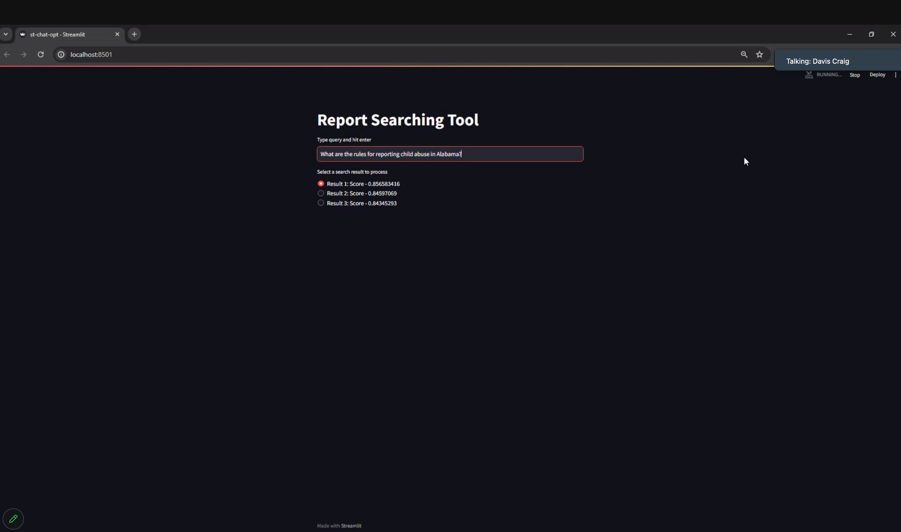

Slide 6
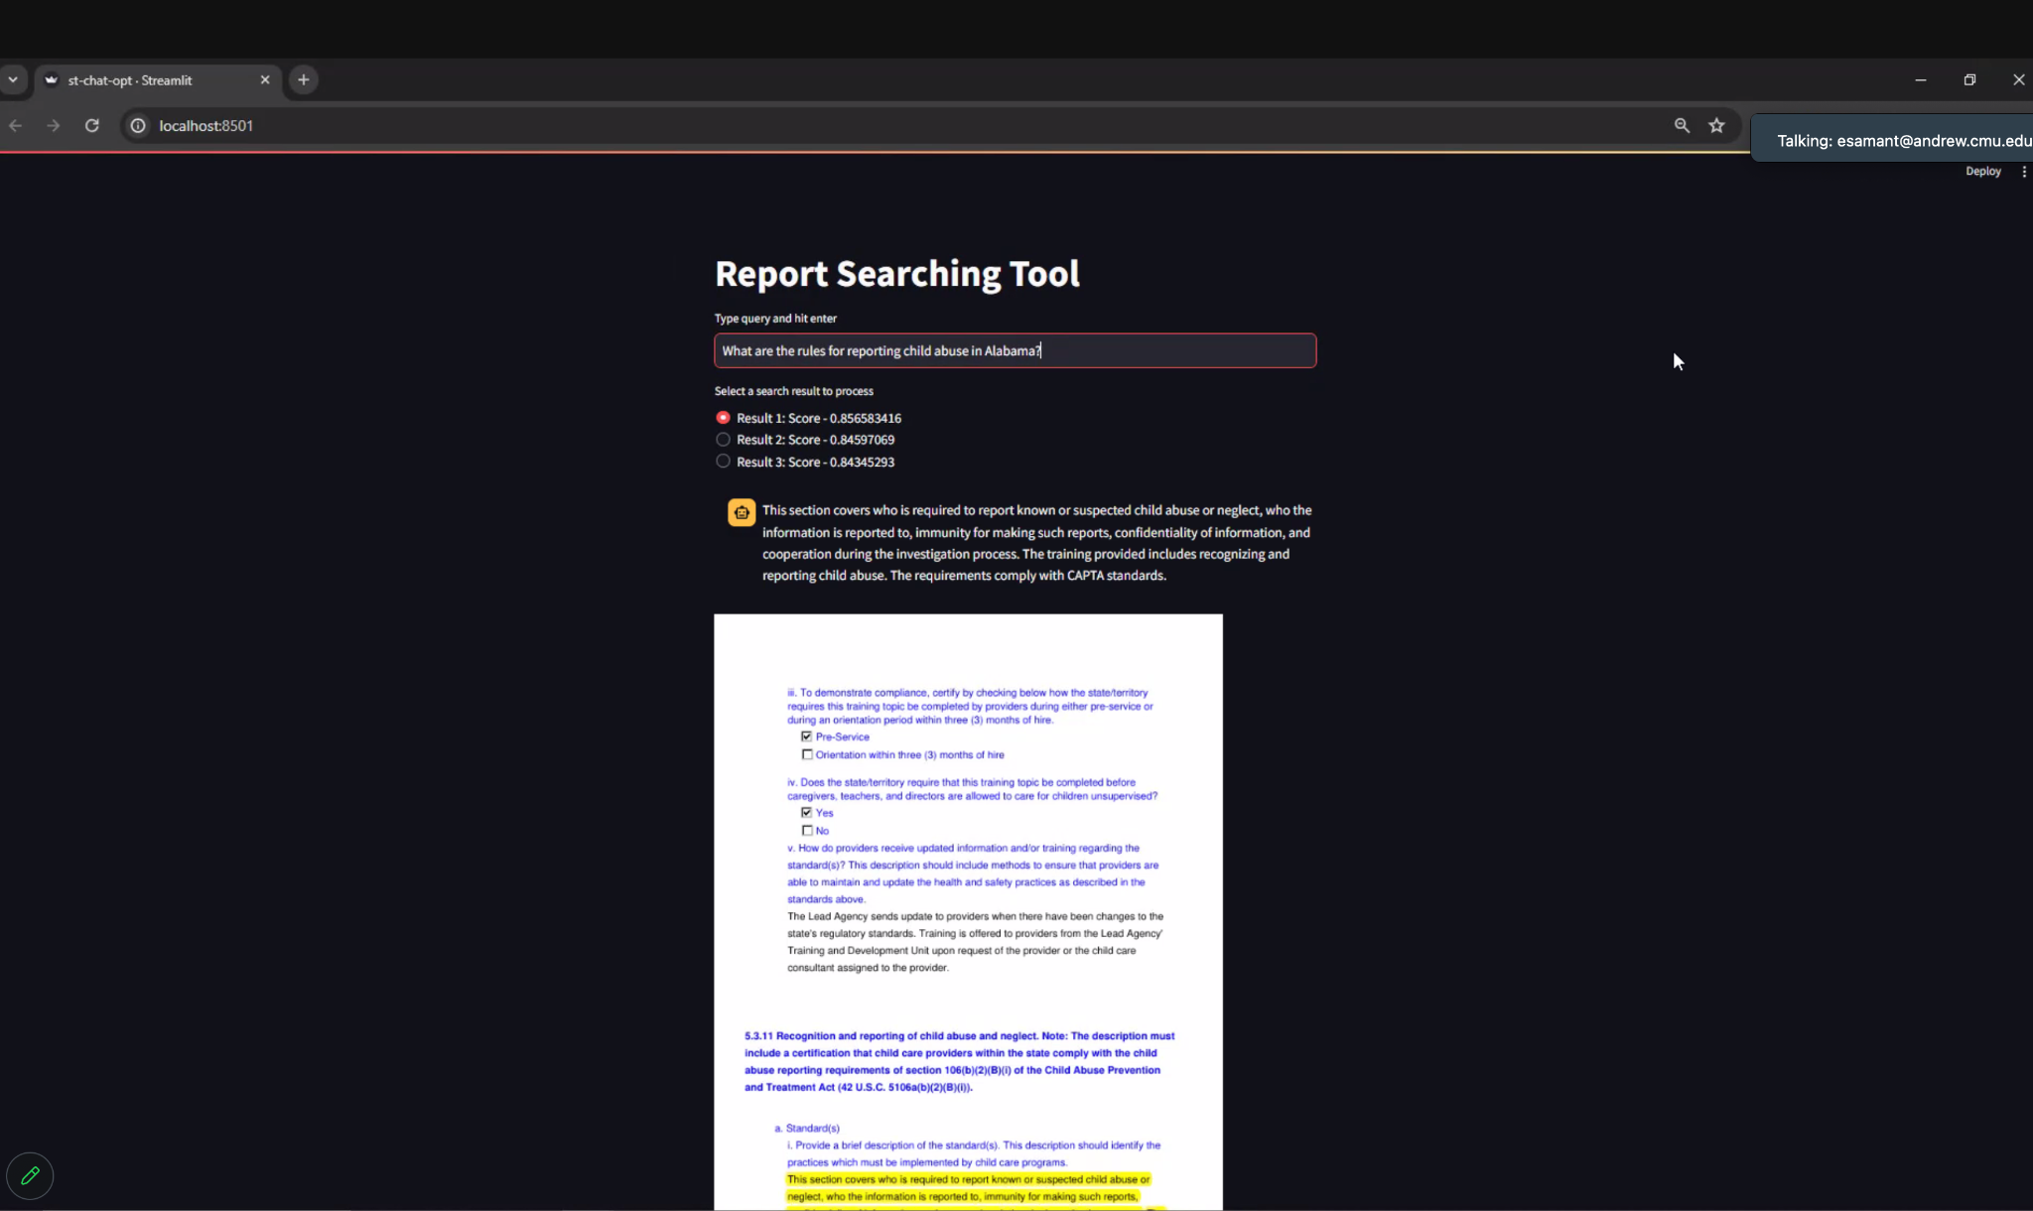

Slide 7
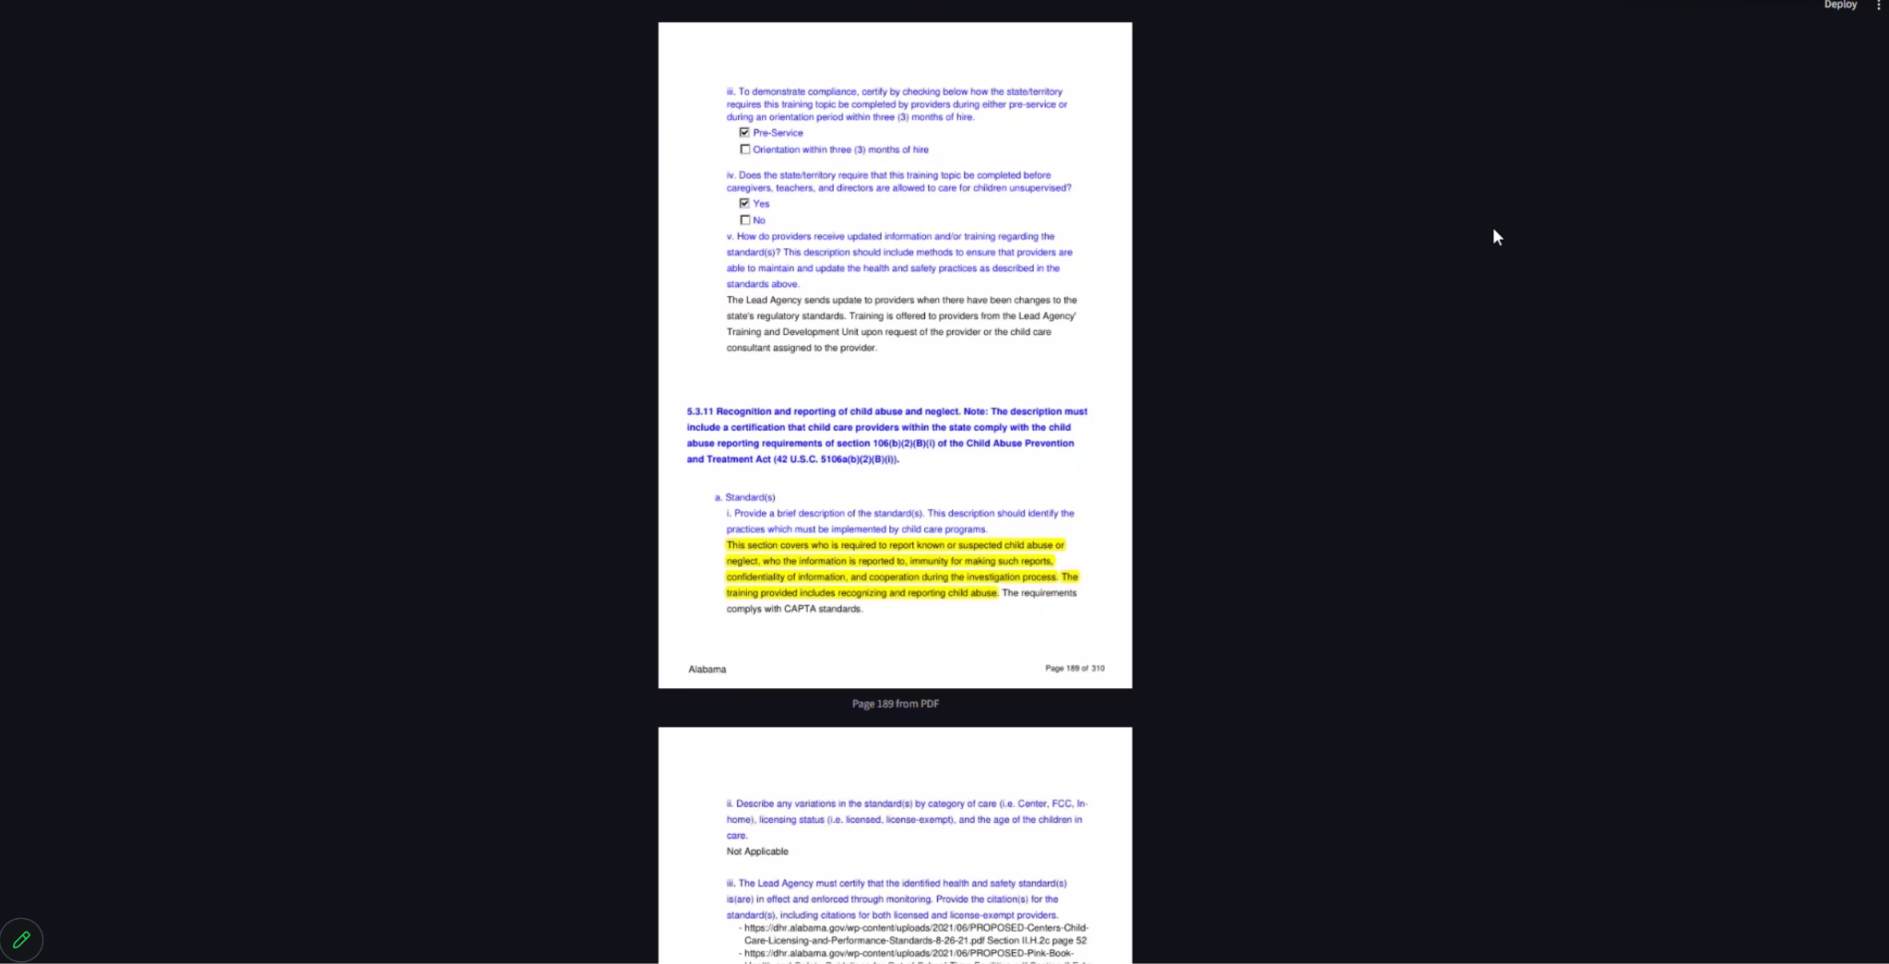

Slide 8
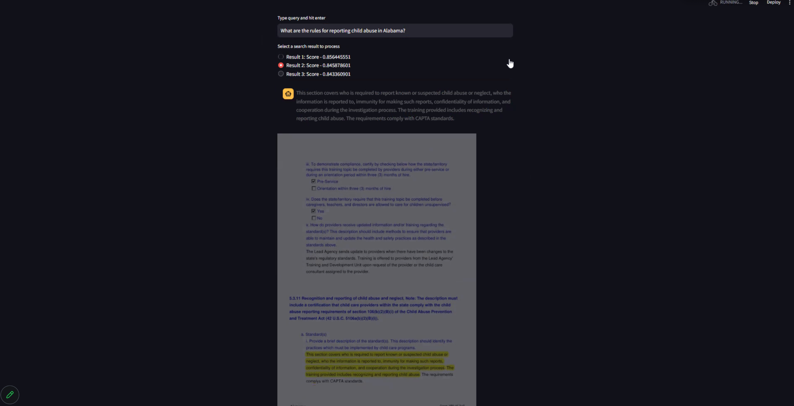

Slide 9
